Slide 1



AI Workshop 5: AI Mini-Hackathon (Online) Saturday 15th March 2025
Omar Choudhry

Slide 2

Starter
Open the following websites:
github.com/omariosc/ai-workshops
colab.google.com

Slide 3
Overview
Find a Dataset – Choose an interesting dataset (your own or something open-source).
Explore & Clean the Data – Identify patterns, trends, and missing values.
Use AI to Uncover Insights – Code using Google Colab & Gemini.
Build AI Models – Follow the Azure flowchart guide.
Visualise & Present – Showcase your work (Workshop 6).

Slide 4
📂 Step 1: Find a Dataset
Possible sources:
Kaggle – A variety of structured datasets
Google Dataset Search – Open data from the web
Data.gov – Government datasets
Our World in Data – Economic, environmental, and health data
💡 Tip: Look for a dataset with at least 500 rows and 5+ columns.

Slide 5
🔎 Step 2: Explore & Clean the Data
Using Google Colab (use Gemini to help code)/ Microsoft Excel (no coding required):
Upload the dataset
Use Python (pandas library), built-in Colab tools or Microsoft Excel to visualise trends
e.g. scatter plots, feature histograms, correlation tables
Identify missing data, extreme values and anomalies
Ask Google Gemini: “What are some interesting insights from this dataset?”
💡 Example: A dataset on carbon emissions → Look at trends across countries over time.

Slide 6
🧠 Step 3: Use AI to Uncover Insights
With Google Gemini/ ChatGPT/ DeepSeek, teams will:
Ask AI to summarise patterns in the data
Generate predictions (e.g., forecasting sales, predicting sentiment from text)
Use classification or clustering (e.g., grouping customer segments)
💡 Example: If using a Netflix dataset, AI can predict the next trending genre.

Slide 7
🤖 Step 4: Build AI Models
Option 1: Colab + Gemini – Prompt engineering to help write your machine learning pipeline
Option 2: Google Teachable Machine – Interface-based model development
Option 3: Google Sheets & AI Plugins – No-code machine learning
Split your data into training and test sets (and try to use validation sets)
Train your model on the training data
Evaluate the best model on the test set (and try to use new external data for testing)
💡 Example: A dataset on stock prices → Use Gemini AI to write code for predicting price movements.

Slide 8
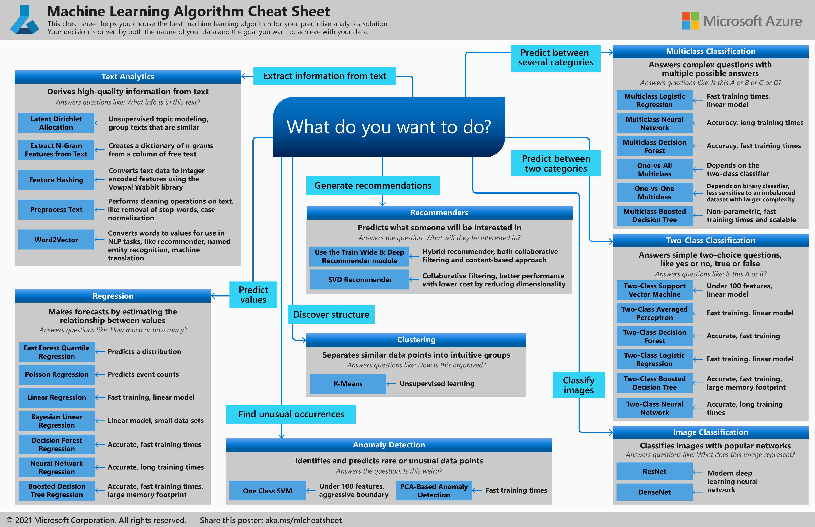
🤖 Step 4: Build AI Models
https://learn.microsoft.com/en-us/azure/machine-learning/algorithm-cheat-sheet?view=azureml-api-1

Slide 9
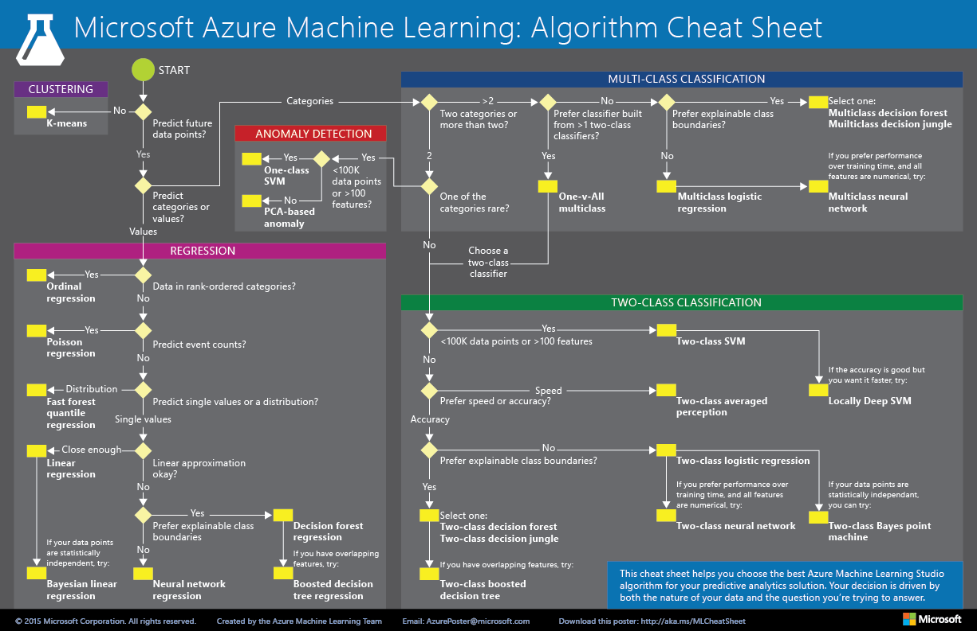
🤖 Step 4: Build AI Models
https://i.pinimg.com/originals/d4/e5/52/d4e552cd83a99fd86c43c45e5cba5d6c.png

Slide 10
📊 Step 5: Visualise & Present Insights
We will do this in Workshop 6: AI Project Showcase (Tuesday 29th April 2025)
Use Google Sheets, Microsoft Excel or Python (matplotlib library) for charts
Create a 5-slide presentation (Story, Data, Insights, AI Model, Key Takeaways)
Keep it visual & engaging (images and figures or simple animations)
💡 Final Challenge: Each team presents their findings in ~10 minutes.

Slide 11
🏆 Judging Criteria
Creativity – Unique angles in data exploration
AI Application – Smart use of AI tools
Clarity – Well-structured insights & visuals
Impact – How useful are the findings?

Slide 12


Contact
Contact
Slides are available at github.com/omariosc/ai-workshops
WhatsApp Community Chat
O.Choudhry@leeds.ac.uk

